Slide 1
Performance is not all you need!
Agus Sudjianto
EVP, Head of Corporate Model Risk, Wells Fargo

Slide 2
Performance is not all you need
Models with similar performance can be very different models
Conceptual soundness—Sensible effect of variables
Outcome Analysis
Model Weakness and Robustness
Fairness
…many others

Slide 3
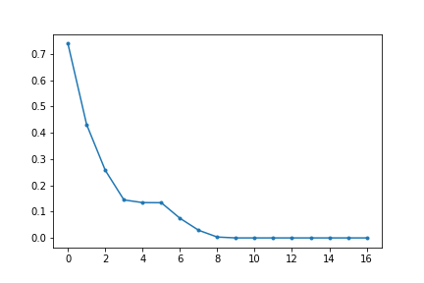
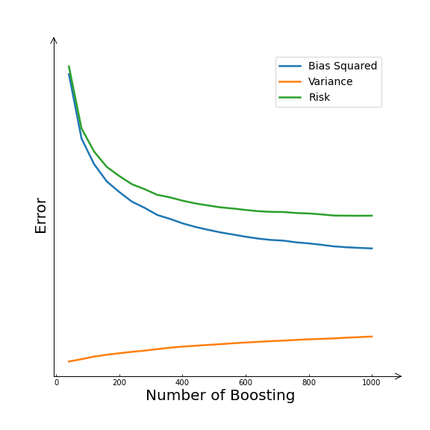
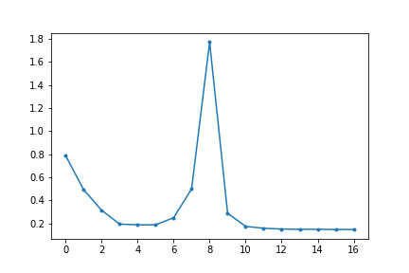
Remarkable World of Over-Parameterized Models
Double Descent
Benign Overfitting
Training error
Test error
But…
Model Complexity

Slide 4
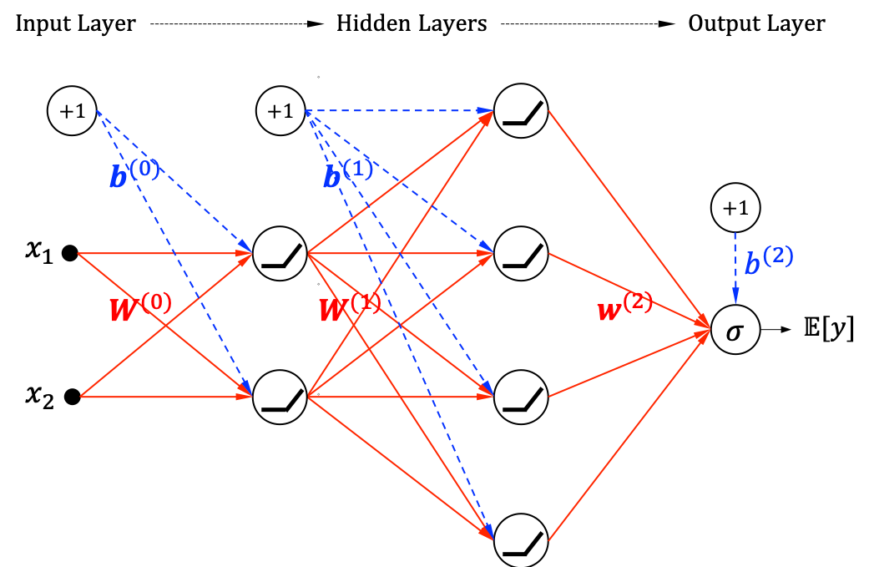
Can We Trust These Models?
Interpretability
Reliability
Uncertainty/Confidence of prediction
Robustness
Sensitivity of small input changes
Resilience
Performance degradation under environment changes

Slide 5
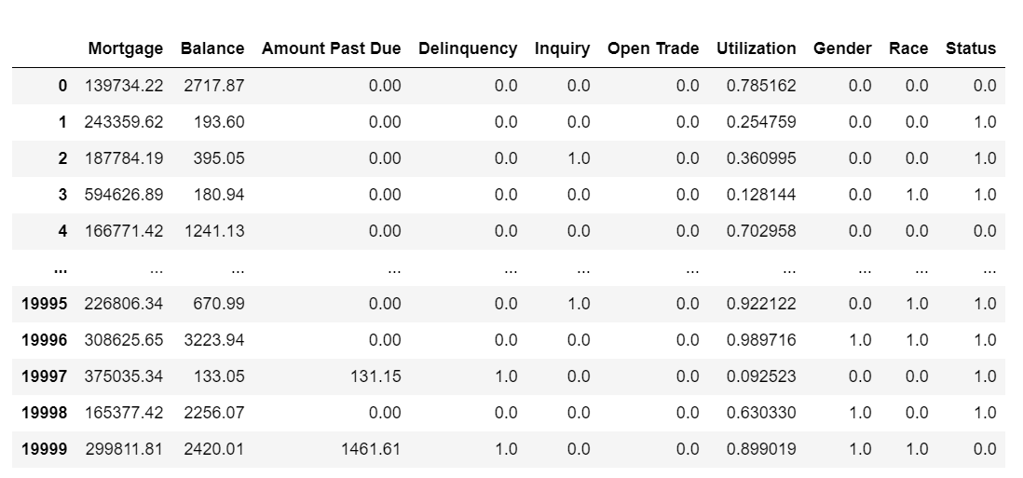
Case Study: Credit Data

Slide 6
Taxonomy of Explainable Machine Learning
Low Performance
Linear/Logistic Regression, Decision Tree (shallow), …
Intrinsic Interpretability
Self-Explanatory Machine Learning
High Performance
Constrained Architecture GAM/GAMI-Net, XGB2/EBM, ReLU DNN, FIGS, …
Model Specific
Explainable Machine Learning
Global Explanation
VI, PDP, ICE, ALE, Global
Post-hoc Explainability
Local Explanation
LIME/Anchors, SHAP, …
Model Agnostic (Black Box)
Surrogate Model
Linear/Logistic Regression, Decision Tree (shallow), …

Slide 7
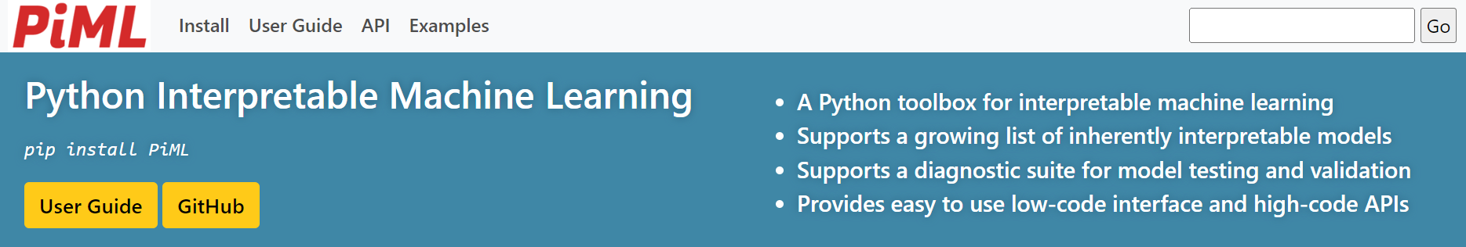
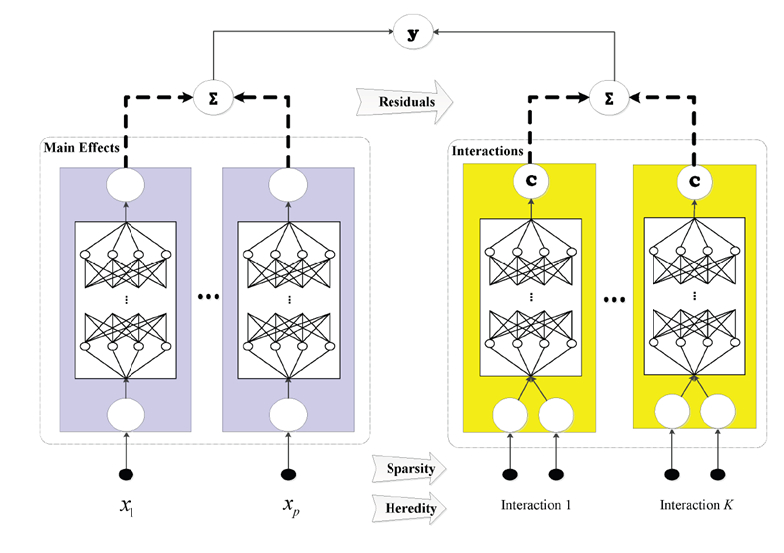
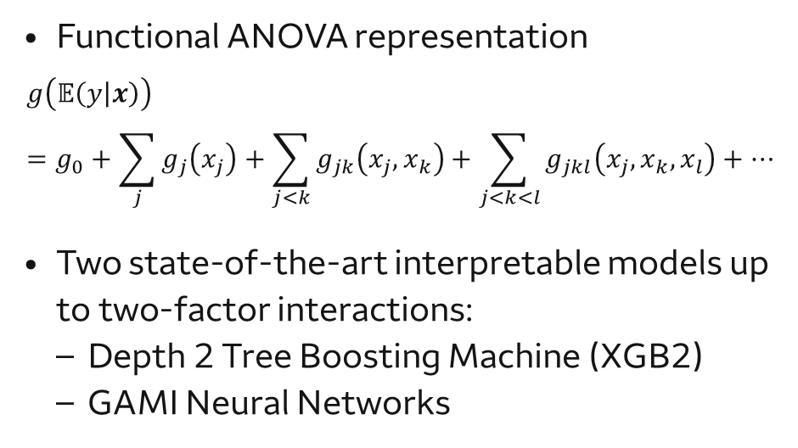
Inherently Interpretable Machine Learning
Functional ANOVA representation
$$g\left(𝔼\left(y | x\right)\right)=g_{0}+\sum_{j}{g_{j}\left(x_{j}\right)}+\sum_{j<k}{g_{jk}\left(x_{j},x_{k}\right)}+\sum_{j<k<l}{g_{jkl}\left(x_{j},x_{k},x_{l}\right)}+…$$
Two state-of-the-art interpretable models up to two-factor interactions:
Depth 2 Tree Boosting Machine (XGB2)
GAMI Neural Networks

Slide 8
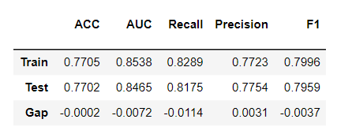
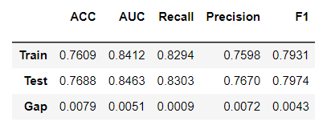
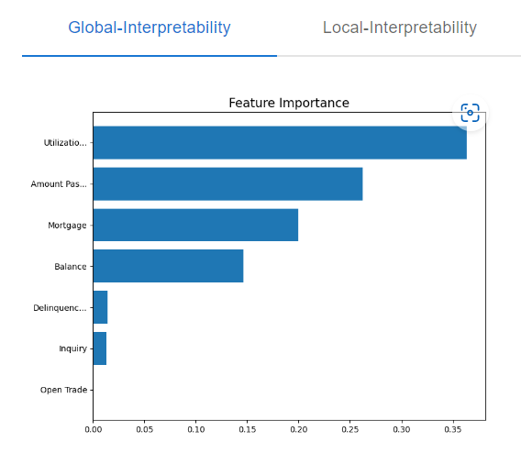
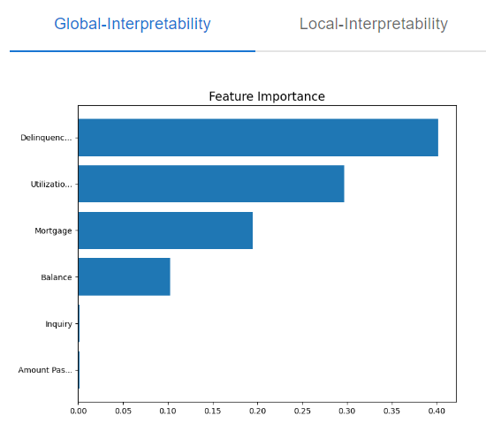
Equal Performance—Very Different Models
XGB2—Depth 2 XGBoost
GAMI Neural Networks

Slide 9
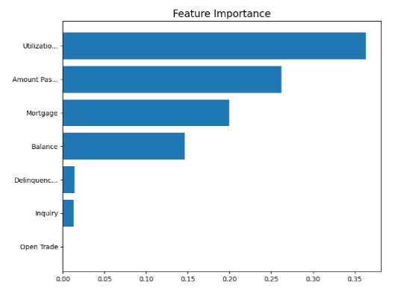
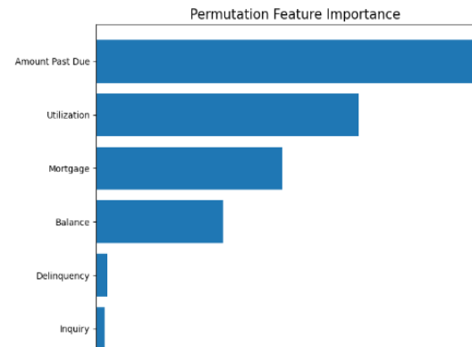
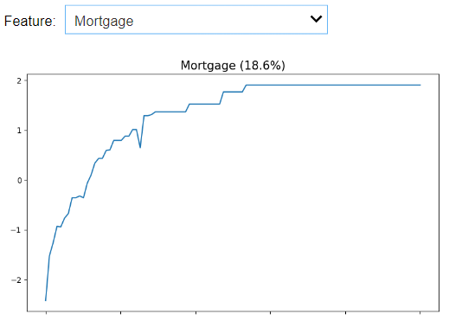
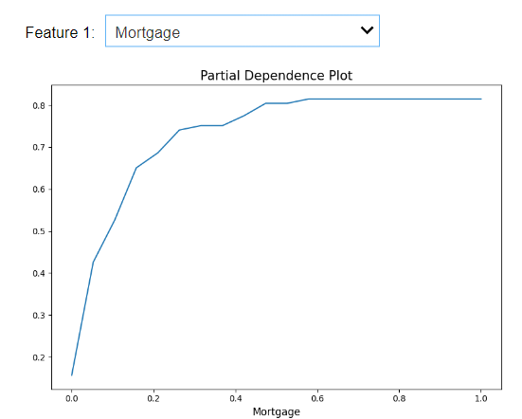
Users Beware of Post-hoc Explainability
Post-hoc Explainer
True (Exact) Explanation

Slide 10
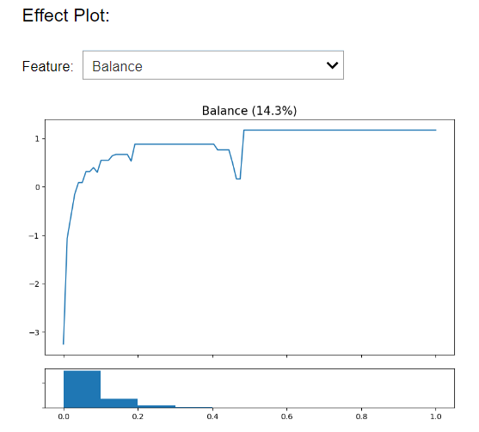
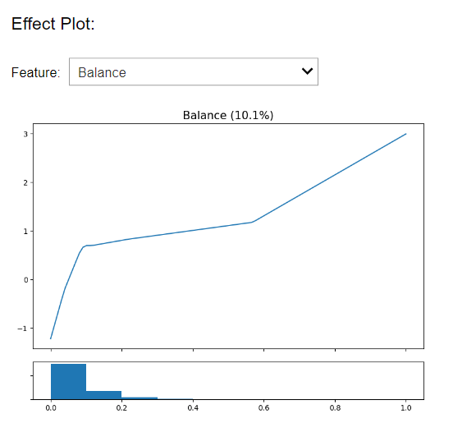
Contrasting Variable (Balance) Effects
XGB2—Depth 2 XGBoost
GAMI Neural Networks

Slide 11
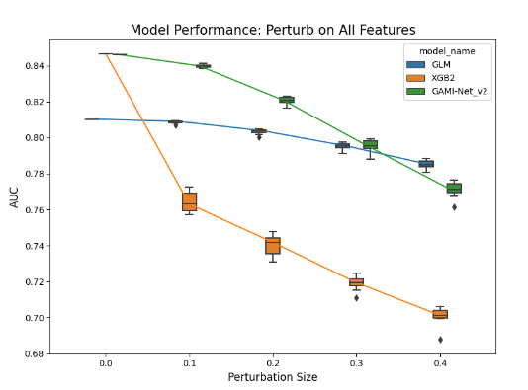
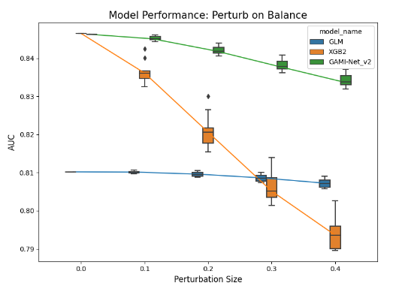
Model Robustness: Sensitivity to Input Noise
How sensitive to noise in the input?
Performance degradation by perturbing input with small random noise

Slide 12
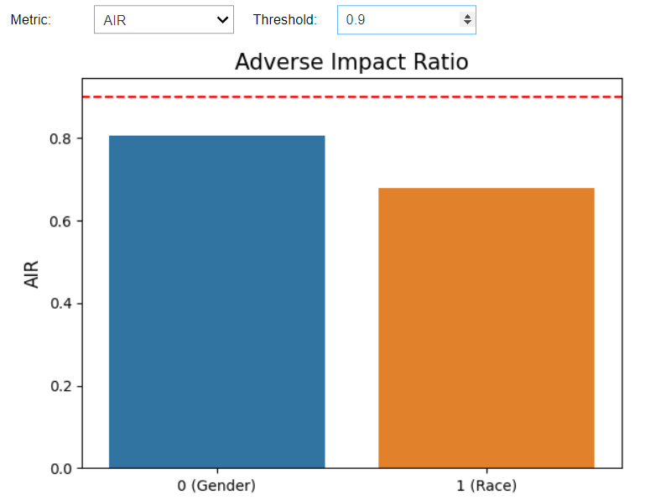
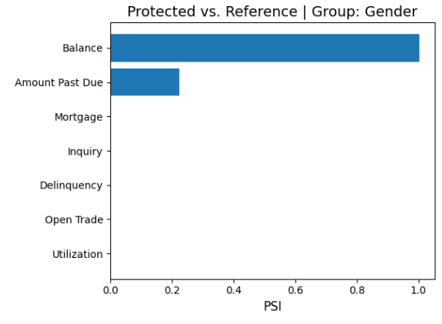
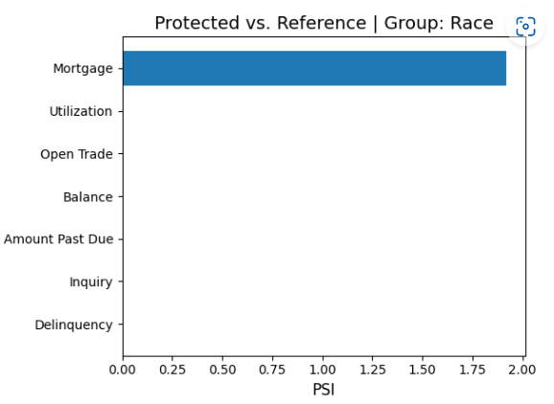
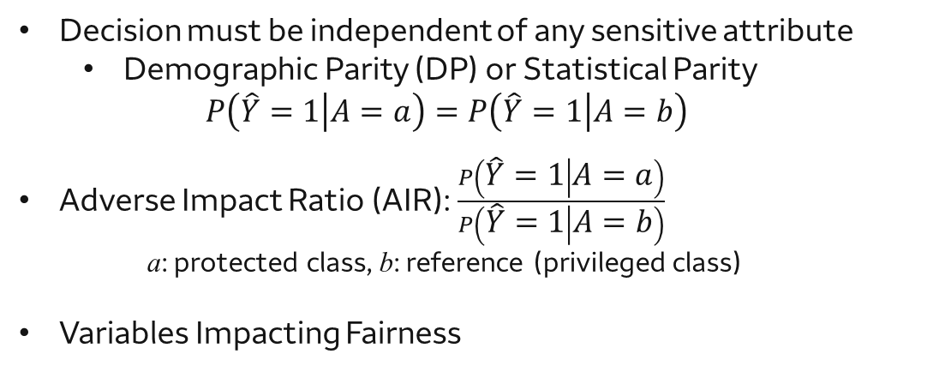
Model Fairness: Effect of Variables to Model Bias
Decision must be independent of any sensitive attribute
Demographic Parity (DP) or Statistical Parity
$$P\left(\hat{Y}=1 | A=a\right)=P\left(\hat{Y}=1 | A=b\right)$$
Adverse Impact Ratio (AIR): $\frac{P\left(\hat{Y}=1 | A=a\right)}{P\left(\hat{Y}=1 | A=b\right)}$
a: protected class, b: reference (privileged class)
Variables Impacting Fairness

Slide 13
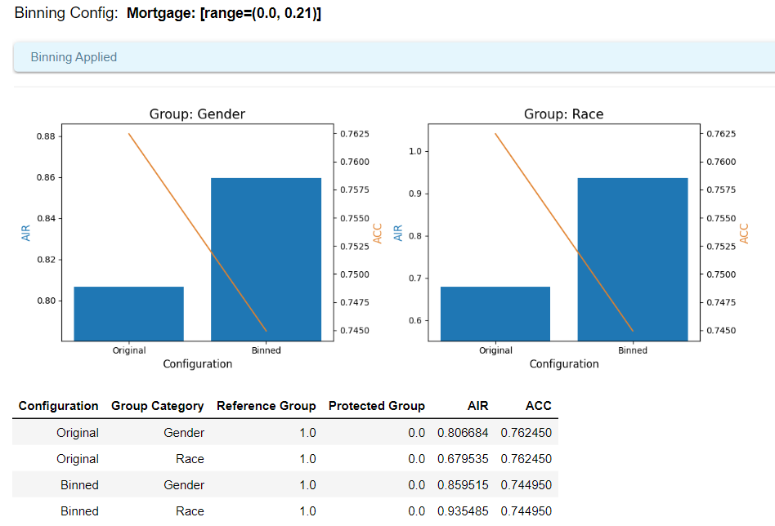
Model De-biasing

Slide 14
Model Diagnostics
Identification of model weakness beyond overall performance
Error analysis: Finding regions with weaker performance
Resilient: Understanding the effect of data drift and regions with weaker performance
Reliability: Understanding prediction uncertainty its associated regions

Slide 15
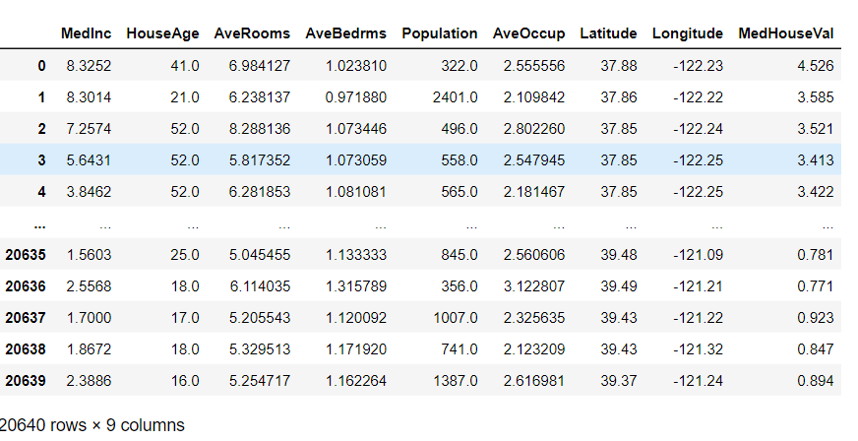
Case Study: California House Price

Slide 16
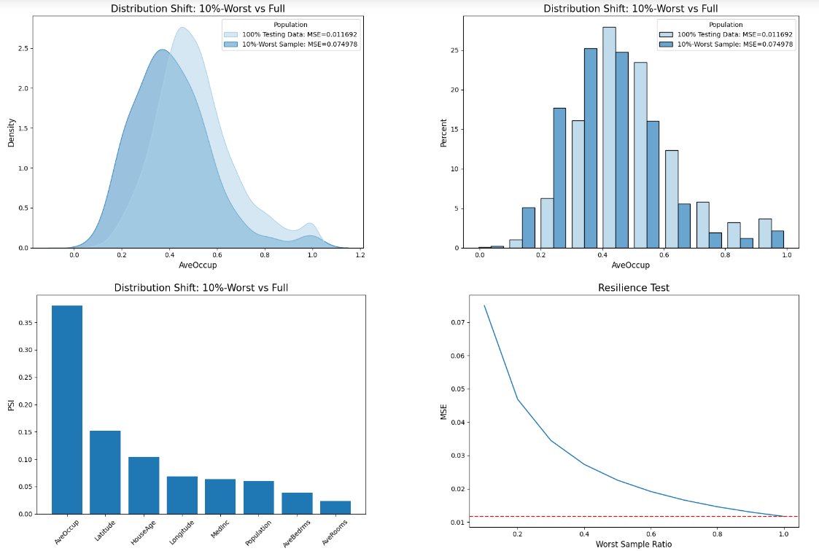
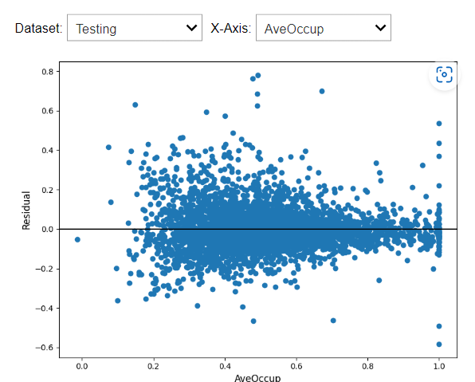
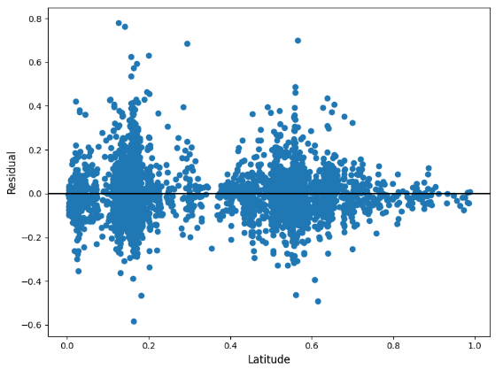
Resilient: Worse Case Error Drift

Slide 17
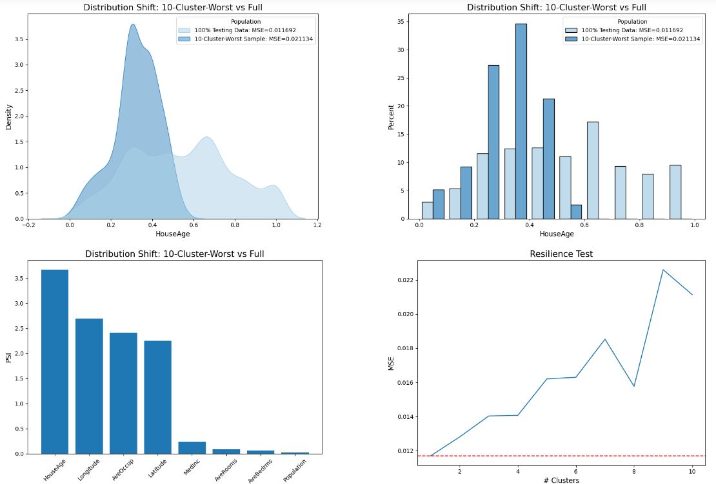
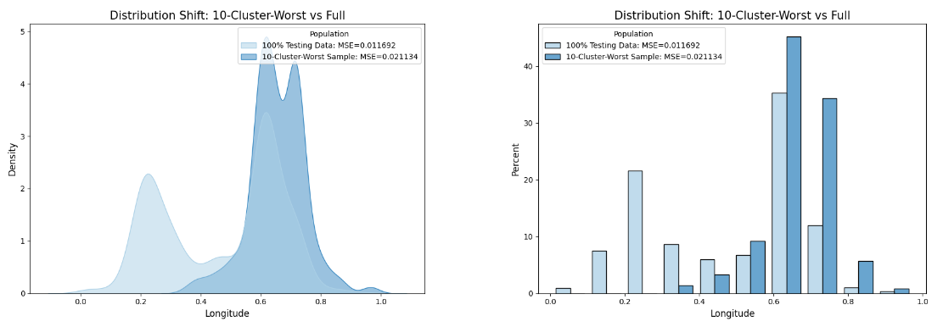
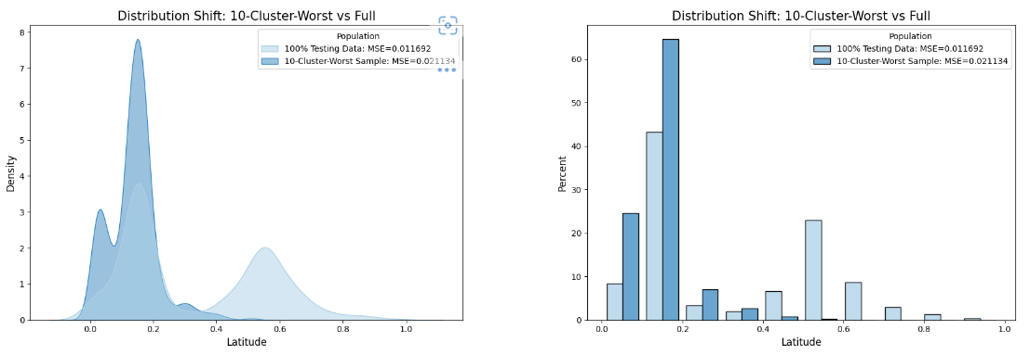
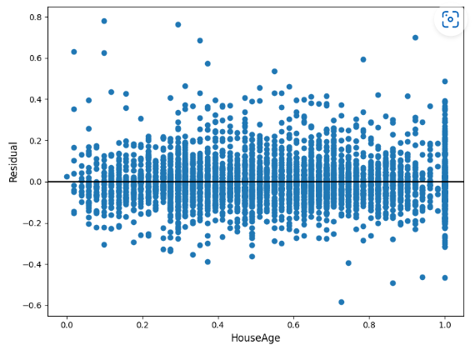
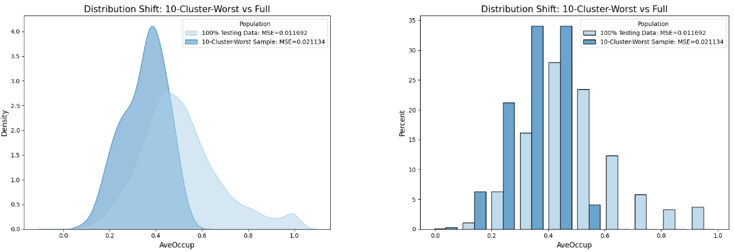
Resilient: Worse Cluster Error Drift

Slide 18
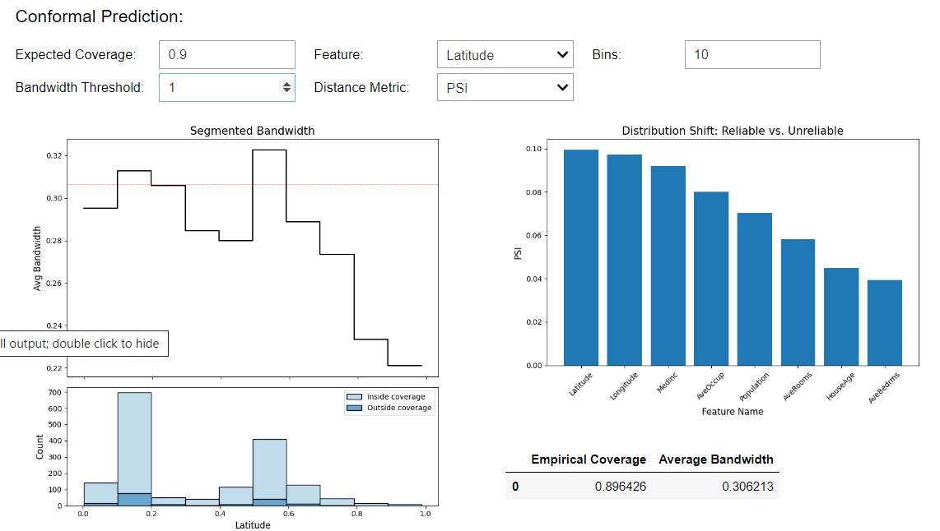
Reliability: Prediction Uncertainty

Slide 19
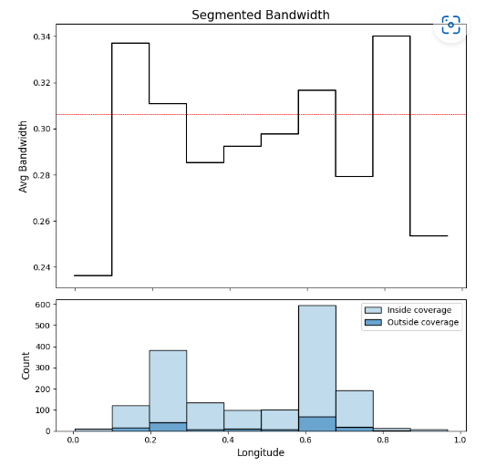
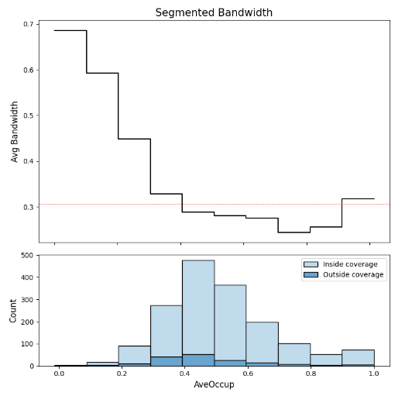
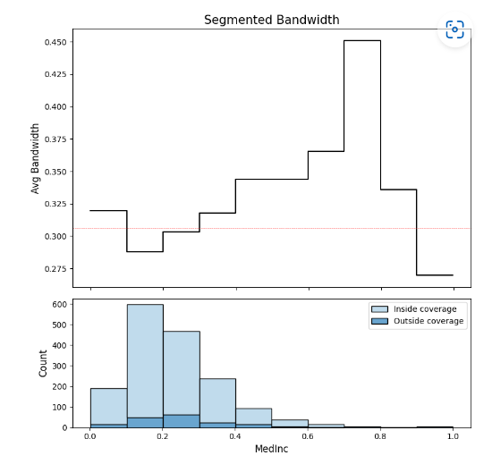
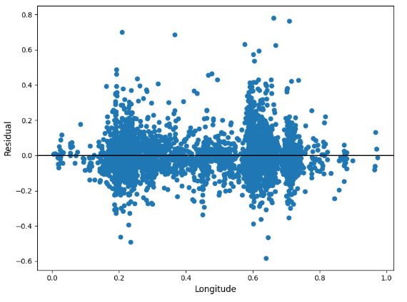
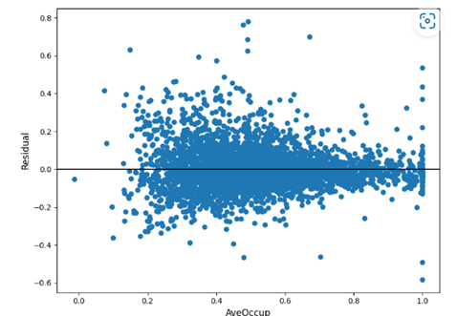
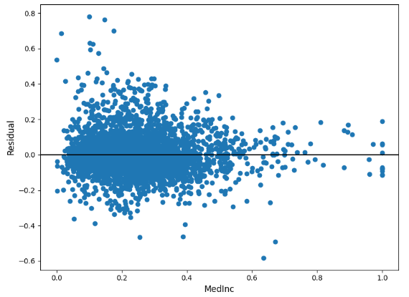
Prediction Uncertainty

Slide 20
Performance is NOT all you need!

